Slide 1
How to Read a Paper
By Linda Lo
Adapted from HOSA 2019 Presentation with Jessica Lundy and PSYB55 Course Content by Prof. Michael Souza

Slide 2
Preparing to Search
Where to Start?
Finding the Right Database
Defining Your Topic
Searching

Slide 3
Where Do I Start?

Slide 4
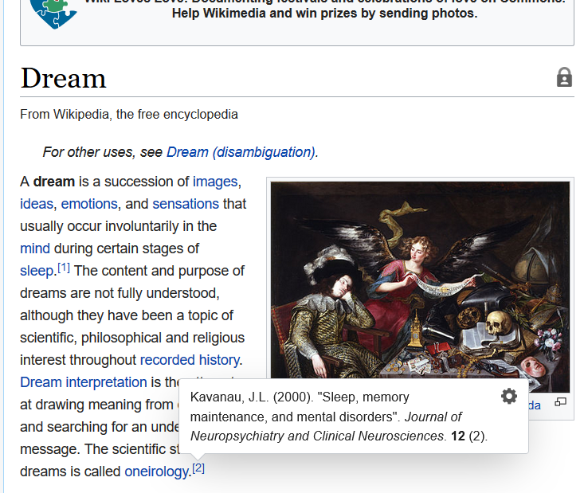
Wikipedia
Good for providing overview of topics
Provides citations that can be further explored
BUT this is not a cite-worthy source

Slide 5
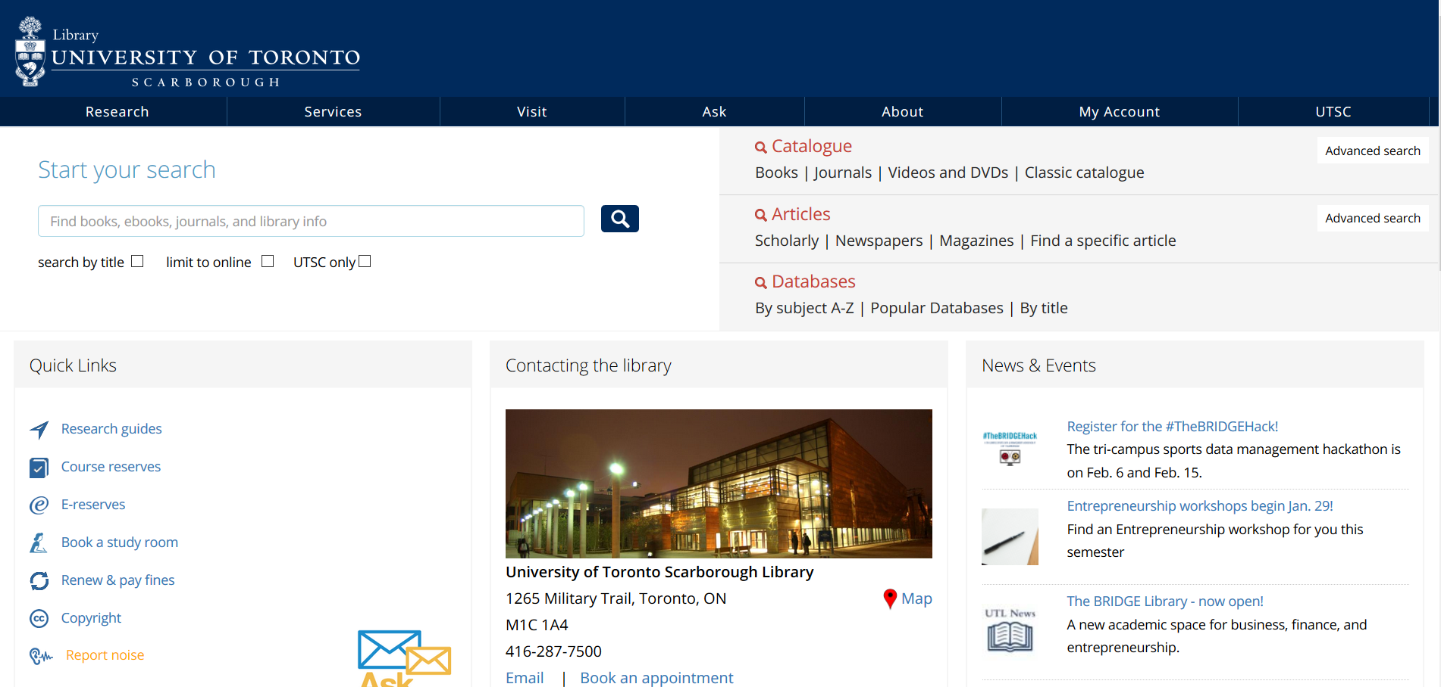
The Library

Slide 6
Finding the Right Database

Slide 7
Google Scholar
Web of Science
IEEE Explore
Common Databases
Scopus
ACM Digital Library
Plos One

Slide 8
Paywall?
Various institutions provide article access
E.g. University of Toronto library website:
https://onesearch.library.utoronto.ca/popular-databases

Slide 9

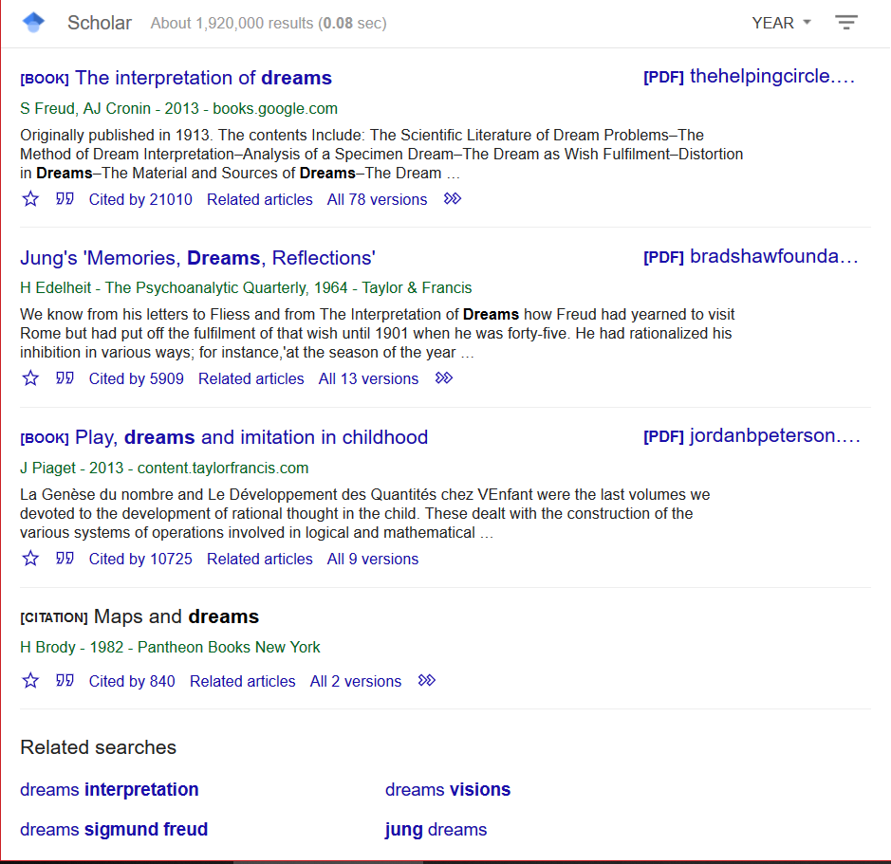
Google Scholar

Slide 10
Defining Your Topic

Slide 11
Decide on a Topic
Research is often very specialized
Narrow it down and be SPECIFIC
Example:
Too General: “Ways people learn”
Improvement: “applications of the VARK model in education”

Slide 12
Key Words
BRAINSTORM
What other words do you associate with your topic?
Some databases will offer additional key words to help refine your search

Slide 13
Searching
Boolean Logic
Wildcards
Citation Chains
Examples

Slide 14
Boolean Logic
Use ‘AND’ to chain terms together
Use ‘OR’ with parentheses to group like terms or alternative spellings
For Example: (colorful OR colourful)
Use ‘-’ to exclude terms
For Example: learning styles -visual

Slide 15
Wildcards
Use an asterix (*) and wildcards (? Or !)
For Example:
Child* brings up child, children, childhood
Globali?ation brings up globalization and globalisation
BUT be careful not to over shorten the word!
Soc* brings up society, socialization but also Socrates!
Note: symbols used for logic and wildcards may vary from website to website, so make sure to read up on the specific database used

Slide 16
Citation Chains
Follow citations from papers you’ve already found for relevant articles
Often meta-analyses of a field are a good place to start!

Slide 17
Examples
(HIV or AIDS) and (television or movie* or film* or motion picture*)
(teen*or adolescen*) and (girl* or female*) aggression

Slide 18
Breaking Down a Paper
Abstract
Introduction
Methods
Results
Discussion

Slide 19
Abstract
Decompose into sections related to the paper
1. Introduction – describes context/purpose
2. Methods – how experiment was done
“Using”, “In...experiment/study”, “We...”
3. Results – data obtained
“shows”, “demonstrates”, <statistics>
4. Discussion – interpretation of data
“suggests”, “interpreted as”, “indicates”

Slide 20
Example
Kawaii (a Japanese word meaning “cute”) things are popular because they produce positive feelings. However, their effect on behavior remains unclear. In this study, three experiments were conducted to examine the effects of viewing cute images on subsequent task performance. In the first experiment, university students performed a fine motor dexterity task before and after viewing images of baby or adult animals. Performance indexed by the number of successful trials increased after viewing cute images (puppies and kittens; M ± SE = 43.9±10.3% improvement) more than after viewing images that were less cute (dogs and cats; 11.9±5.5% improvement). In the second experiment, this finding was replicated by using a non-motor visual search task. Performance improved more after viewing cute images (15.7±2.2% improvement) than after viewing less cute images (1.4±2.1% improvement). Viewing images of pleasant foods was ineffective in improving performance (1.2±2.1%). In the third experiment, participants performed a global–local letter task after viewing images of baby animals, adult animals, and neutral objects. In general, global features were processed faster than local features. However, this global precedence effect was reduced after viewing cute images. Results show that participants performed tasks requiring focused attention more carefully after viewing cute images. This is interpreted as the result of a narrowed attentional focus induced by the cuteness-triggered positive emotion that is associated with approach motivation and the tendency toward systematic processing. For future applications, cute objects may be used as an emotion elicitor to induce careful behavioral tendencies in specific situations, such as driving and office work.

Slide 21
Example Cont.
Kawaii (a Japanese word meaning “cute”) things are popular because they produce positive feelings. However, their effect on behavior remains unclear. In this study, three experiments were conducted to examine the effects of viewing cute images on subsequent task performance. In the first experiment, university students performed a fine motor dexterity task before and after viewing images of baby or adult animals. Performance indexed by the number of successful trials increased after viewing cute images (puppies and kittens; M ± SE = 43.9±10.3% improvement) more than after viewing images that were less cute (dogs and cats; 11.9±5.5% improvement). In the second experiment, this finding was replicated by using a non-motor visual search task. Performance improved more after viewing cute images (15.7±2.2% improvement) than after viewing less cute images (1.4±2.1% improvement). Viewing images of pleasant foods was ineffective in improving performance (1.2±2.1%). In the third experiment, participants performed a global–local letter task after viewing images of baby animals, adult animals, and neutral objects. In general, global features were processed faster than local features. However, this global precedence effect was reduced after viewing cute images. Results show that participants performed tasks requiring focused attention more carefully after viewing cute images. This is interpreted as the result of a narrowed attentional focus induced by the cuteness-triggered positive emotion that is associated with approach motivation and the tendency toward systematic processing. For future applications, cute objects may be used as an emotion elicitor to induce careful behavioral tendencies in specific situations, such as driving and office work.

Slide 22
Abstract Goals
1. To be able to summarize the core features of the paper
2. To determine whether it is relevant to what you are currently researching
Exercise: Summarize the main purpose and experiment of the following abstract…

Slide 23
Exercise
Drawing from the view that positive and negative emotions are incompatible within momentary experience, it was hypothesized that positive affect in studying would prevent subsequent negative affect in studying. A sample of 126 college students completed the Positive and Negative Affect Schedule – Short Form with reference to their current experience when studying on two occasions 3 months apart. Mediation modeling revealed a proximal indirect effect, in that positive affect prevents negative affect at baseline, and the reduction effect carries on over time, and a less enduring distal indirect effect, in that positive affect at baseline fosters subsequent positive affect, which in turn prevents negative affect. The findings support the hypothesis and provide indications for research aiming at reducing negative affect in studying.

Slide 24
Introduction
From broad to specific
Context
Subfield
Topic
Hypothesis
Summarize paragraphs in 1-2 sentences
For complicated articles, make a list of new terms

Slide 25
Introduction Goals
1. Give context for the research
2. State what is known and what is not known (gaps)
3. Describe how current experiment addresses the gap
4. Posit a hypothesis for results
Exercise: Skimming through the introduction, can someone describe what points 3 & 4 are for experiment 1?

Slide 26
Methods
One of the most technically challenging
For researchers – allows for replications
For readers – allows for critical evaluation of the process
Create a flow chart!
Experiment over time
Diff groups & # of people in each group
Tasks/tests done and what is measured

Slide 27
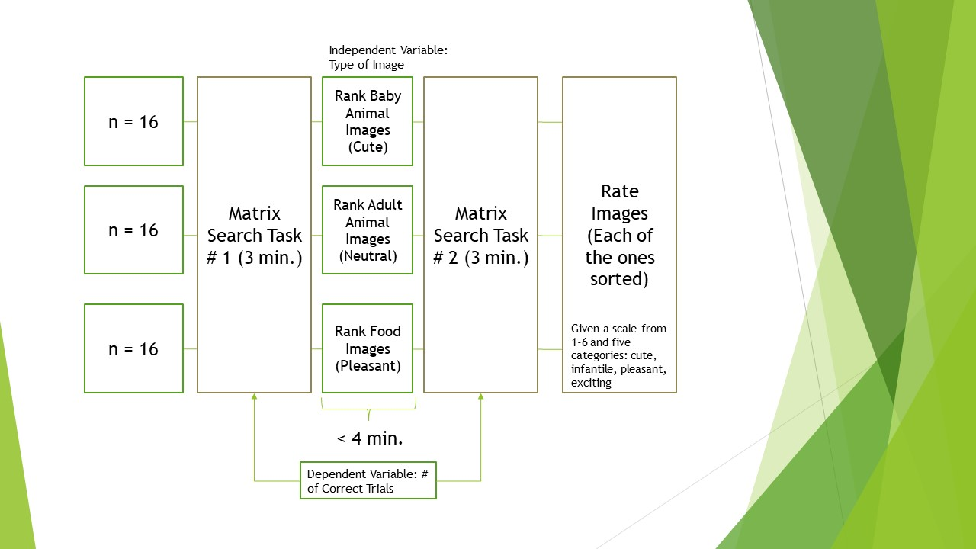
Example

Slide 28
Method Goals
1. Get a conceptual understanding of the procedure used
2. Know the key variables being manipulated
Exercise: Skimming through the methods of experiment 1 can someone tell me the flow of events? What variables are being measured?

Slide 29
Results
Key findings of the study supported by statistical analysis and presented in figures/tables
Pay attention to the figures first!
Figures: Orient yourself to the axes and highlighted features
Tables: Orient yourself to columns/rows and significance markers
Describe results in as concise a manner as possible
Read text afterwards to compare

Slide 30
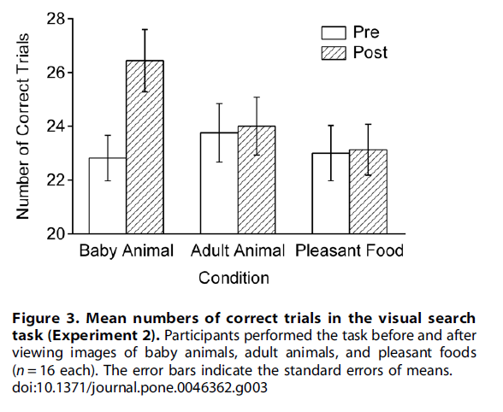
Example
Only the condition with baby animals seems to indicate an increased performance in visual search.

Slide 31
Results Goals
Determine whether the data supports the hypothesis of the experiment(s).
Exercise: Examining experiment 1 figures, does the data seem to support the initial hypothesis?

Slide 32
Discussion
Highlights the following:
Major points of paper
Findings in context of research
Limitations & future directions
Similar to introduction section: synthesize paragraphs in 1-2 sentences

Slide 33
Discussion Goals
Understand author’s interpretations of results and where future research is needed.
Exercise: Skim through the paragraphs of the discussion. Does it address the 3 areas mentioned before?

Slide 34
Thank you for listening to this presentation!
Please attempt the practice article in your own time.

